Slide 1


Smart Route Planner

Slide 2

Team Members:
KIRITHIK : RA2211003010138
Manav : RA2211003010135
Harsh Jain : RA2211003010141

Slide 3
Key Components:
Graph Representation: Efficient data structures are utilized to represent the road network as a graph, with nodes representing intersections and edges representing road segments. Graph traversal algorithms are employed to explore possible routes between source and destination points.
Real-Time Traffic Updates: The system integrates real-time traffic data from external sources, such as GPS devices and traffic sensors, to dynamically adjust route recommendations based on current traffic conditions. This involves the use of dynamic programming and heuristic optimization techniques to adapt routes in response to changing traffic patterns.
User Preferences: The Smart Route Planner incorporates user preferences and constraints, such as preferred modes of transportation, avoidance of toll roads, or desire for scenic routes. This involves developing algorithms to prioritize routes based on user-defined criteria while ensuring optimality in terms of time and distance.
Optimization Techniques: The project employs various optimization techniques from DAA to improve the efficiency of route planning algorithms. This includes heuristic search, pruning strategies, and parallelization to reduce computational overhead and improve response times.

Slide 4
Problem Statement:
Route planning is the process of computing the effective method of transportation or transfers through several stops. Basically, the route planning is used to ascertain which route is the most cost-effective when moving from one place to another. Generally, logistics or transport companies use applications/software for route planning and to compile the required routes.

Slide 5
Abstract:
Travel route planning techniques for motor and electric vehicles are designed to find the optimal path from the start to the destination point on a roadmap. As traffic conditions can change very quickly during the journey, it is necessary to immediately update all changes in real time. For example, traffic congestion may occur in certain parts of the route due to an increased number of vehicles. The shortest path generally may not be in all cases the best path, as many conditions can affect the length of the journey. If we want to make our cities smart, the transportation system also has to be smart. In this paper, a practically implemented system for vehicle route planning in urban areas is presented, which works in real time and takes a large number of parameters of travel into account. Therefore, this system provides an estimation of travel time that is much more accurate than the standard auto router.

Slide 6
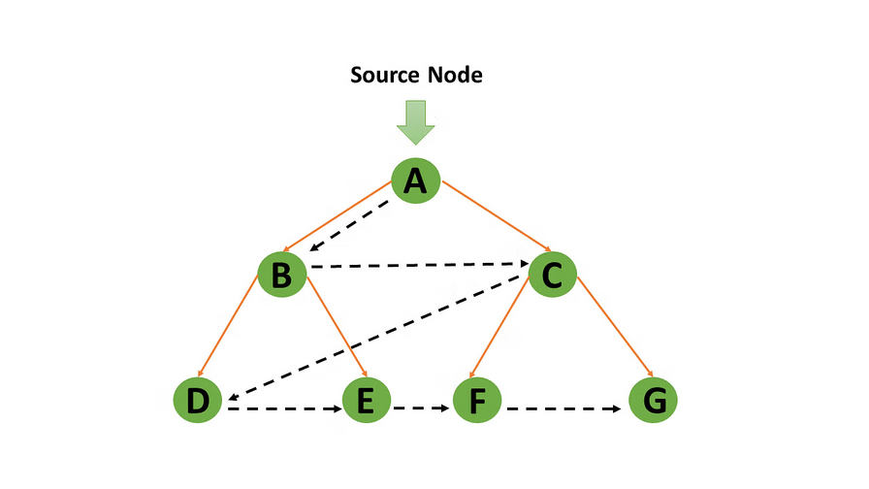
Breadth First Search Algorithm:
Breadth First Search Algorithm:The bfs_shortest_path function takes three arguments: graph, start, and end. The graph is represented as an adjacency list where each vertex is associated with a list of its neighbors. start is the starting vertex, and end is the destination vertex.
The algorithm uses a queue to perform a breadth-first traversal of the graph. It starts by enqueuing the start vertex along with its path, which initially contains only the start vertex. The visited set is used to keep track of the visited vertices to avoid revisiting them.
In each iteration of the while loop, it dequeues a vertex and its path from the queue. If the dequeued vertex is the destination vertex, it returns the shortest path found so far.

Slide 7
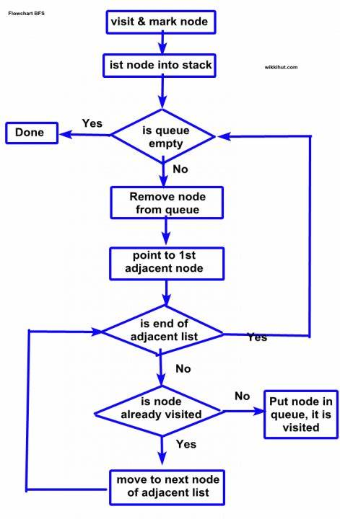
Flow Chart for Breadth First Search Algorithm:

Slide 8
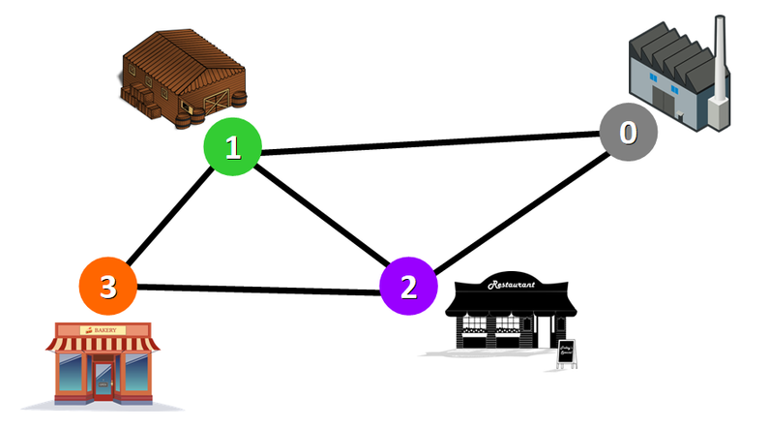
Dijkstra's Algorithm:
Dijkstra's Algorithm: Dijkstra's Algorithm is a Graph algorithm that finds the shortest path from a source vertex to all other vertices in the Graph (single source shortest path). It is a type of Greedy Algorithm that only works on Weighted Graphs having positive weights. The time complexity of Dijkstra's Algorithm is O(V2) with the help of the adjacency matrix representation of the graph. This time complexity can be reduced to O((V + E) log V) with the help of an adjacency list representation of the graph, where V is the number of vertices and E is the number of edges in the graph.

Slide 9
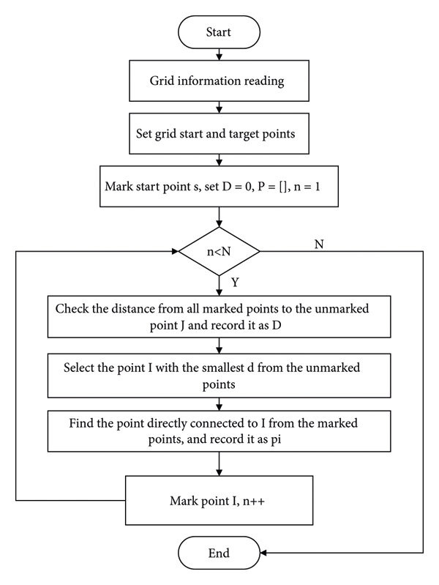
Flow Chart for Dijkstra's Algorithm:

Slide 10
Implementation of Dijkstra’s Algorithm
#include <stdio.h>
#include <stdlib.h>
#include <limits.h>
int findMinDistanceVertex(int dist[], int sptSet[], int V) {
int min = INT_MAX, minIndex;
for (int v = 0; v < V; v++) {
if (!sptSet[v] && dist[v] < min) {
min = dist[v];
minIndex = v;
}
}
return minIndex;
}
void printShortestDistances(int dist[], int V) {
printf("Shortest distances from the source node:\n");
for (int i = 0; i < V; i++) {
printf("To node %d: %d\n", i, dist[i]);
}
}
void performDijkstra(int **graph, int V, int src) {
int *dist = (int *)malloc(V * sizeof(int));
int *sptSet = (int *)malloc(V * sizeof(int));
// Initialize arrays
for (int i = 0; i < V; i++) {
dist[i] = INT_MAX;
sptSet[i] = 0;
}
// Distance from source to itself is always 0
dist[src] = 0;
// Find shortest path for all vertices
for (int count = 0; count < V - 1; count++) {
// Pick the minimum distance vertex from the set of vertices not yet processed
int u = findMinDistanceVertex(dist, sptSet, V);
// Mark the picked vertex as visited
sptSet[u] = 1;

Slide 11
for (int v = 0; v < V; v++) {
if (!sptSet[v] && graph[u][v] && dist[u] != INT_MAX &&
dist[u] + graph[u][v] < dist[v]) {
dist[v] = dist[u] + graph[u][v];
}
}
}
// Print the solution (shortest distances)
printShortestDistances(dist, V);
free(dist);
free(sptSet);
}
int main() {
int V, src;
// Get user input for the number of points (V)
printf("Enter the number of points: ");
scanf("%d", &V);
int **graph = (int **)malloc(V * sizeof(int *));
for (int i = 0; i < V; i++) {
graph[i] = (int *)malloc(V * sizeof(int));
}
for (int i = 0; i < V; i++) {
for (int j = 0; j < V; j++) {
if (i != j) {
printf("Enter the weight for edge (%d, %d): ", i, j);
scanf("%d", &graph[i][j]);
}
}
}
// Get user input for the source node
printf("Enter the source node: ");
scanf("%d", &src);
// Perform Dijkstra's algorithm with the given input
performDijkstra(graph, V, src);
// Free dynamically allocated memory
for (int i = 0; i < V; i++) {
free(graph[i]);
}
free(graph);
return 0;
}

Slide 12
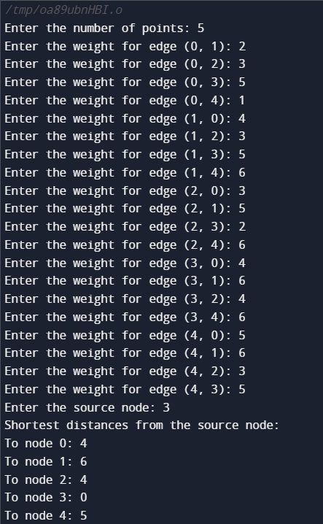
OUTPUT

Slide 13
Implementation of Breadth First
Search Algorithm
#include <stdio.h>
#include <stdlib.h>
#include <limits.h>
typedef struct Queue {
int front, rear;
int *array;
unsigned capacity;
} Queue;
Queue *createQueue(unsigned capacity) {
Queue *queue = (Queue *)malloc(sizeof(Queue));
queue->capacity = capacity;
queue->front = queue->rear = -1;
queue->array = (int *)malloc(queue->capacity * sizeof(int));
return queue;
}
int isEmpty(Queue *queue) {
return (queue->front == -1);
}
void enqueue(Queue *queue, int item) {
queue->array[++queue->rear] = item;
if (queue->front == -1)
queue->front = 0;
}
int dequeue(Queue *queue) {
int item = queue->array[queue->front];
if (queue->front == queue->rear)
queue->front = queue->rear = -1;
else
queue->front++;
return item;
}
int findMinDistanceVertex(int dist[], int sptSet[], int V) {
int min = INT_MAX, minIndex;
for (int v = 0; v < V; v++) {
if (!sptSet[v] && dist[v] < min) {
min = dist[v];
minIndex = v;
}
}
return minIndex;
}

Slide 14
void printShortestDistances(int dist[], int V) {
printf("Shortest distances from the source node:\n");
for (int i = 0; i < V; i++) {
printf("To node %d: %d\n", i, dist[i]);
}
}
void performBFS(int **graph, int V, int src) {
int *dist = (int *)malloc(V * sizeof(int));
int *sptSet = (int *)malloc(V * sizeof(int));
// Initialize arrays
for (int i = 0; i < V; i++) {
dist[i] = INT_MAX;
sptSet[i] = 0;
}
// Distance from source to itself is always 0
dist[src] = 0;
Queue *queue = createQueue(V);
enqueue(queue, src);
while (!isEmpty(queue)) {
int u = dequeue(queue);
sptSet[u] = 1;
for (int v = 0; v < V; v++) {
if (!sptSet[v] && graph[u][v] && dist[u] != INT_MAX) {
dist[v] = dist[u] + 1;
enqueue(queue, v);
}
}
}
// Print the solution (shortest distances)
printShortestDistances(dist, V);
free(dist);
free(sptSet);
}
int main() {
int V, src;
// Get user input for the number of points (V)
printf("Enter the number of points: ");
scanf("%d", &V);
int **graph = (int **)malloc(V * sizeof(int *));
for (int i = 0; i < V; i++) {
graph[i] = (int *)malloc(V * sizeof(int));
}

Slide 15
// Get user input for edge weights
for (int i = 0; i < V; i++) {
for (int j = 0; j < V; j++) {
if (i != j) {
printf("Enter the weight for edge (%d, %d): ", i, j);
scanf("%d", &graph[i][j]);
}
}
}
// Get user input for the source node
printf("Enter the source node: ");
scanf("%d", &src);
// Perform BFS with the given input
performBFS(graph, V, src);
// Free dynamically allocated memory
for (int i = 0; i < V; i++) {
free(graph[i]);
}
free(graph);
return 0;
}

Slide 16
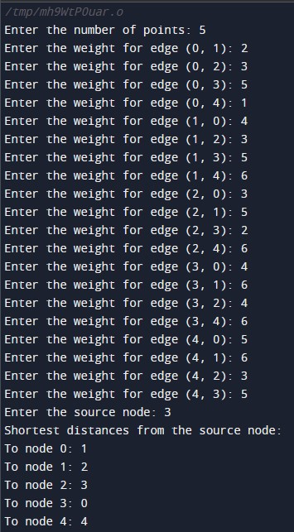
OUTPUT

Slide 17
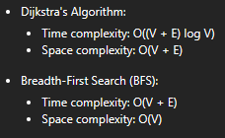
Time and Space
complexity

Slide 18
Benefit:
Optimality
Efficiency
Applicability
Adaptability
Ease of Implementation
Scalability
Widely Studied and Supported

Slide 19
Thank you

